Slide 1
Google Developer Groups Newport Beach x RocketRide
Highlight Reel Pipeline
- Wilson Choi

Slide 2
Wilson Choi
Video Highlight Generator using RocketRide Pipeline x Gemini AI
Analyzes videos and creates a highlight reel based on AI recommendations.
THE VISION

Slide 3
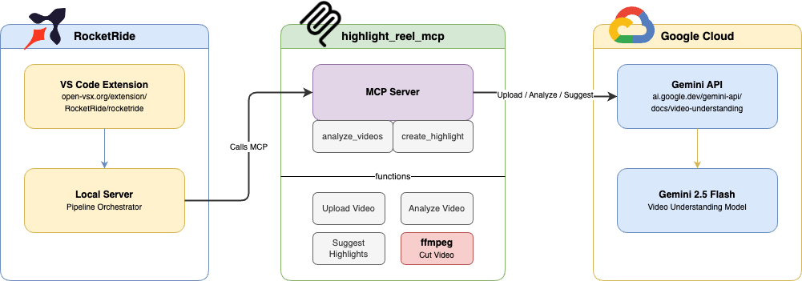
Wilson Choi
Overview

Slide 4
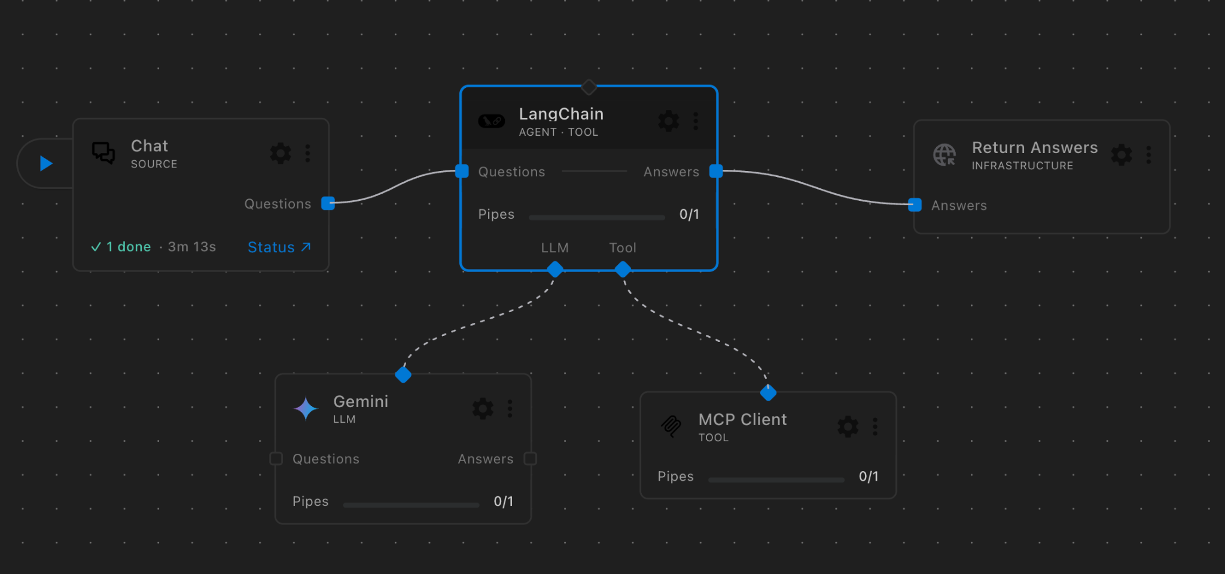
Wilson Choi
RocketRide Pipeline

Slide 5
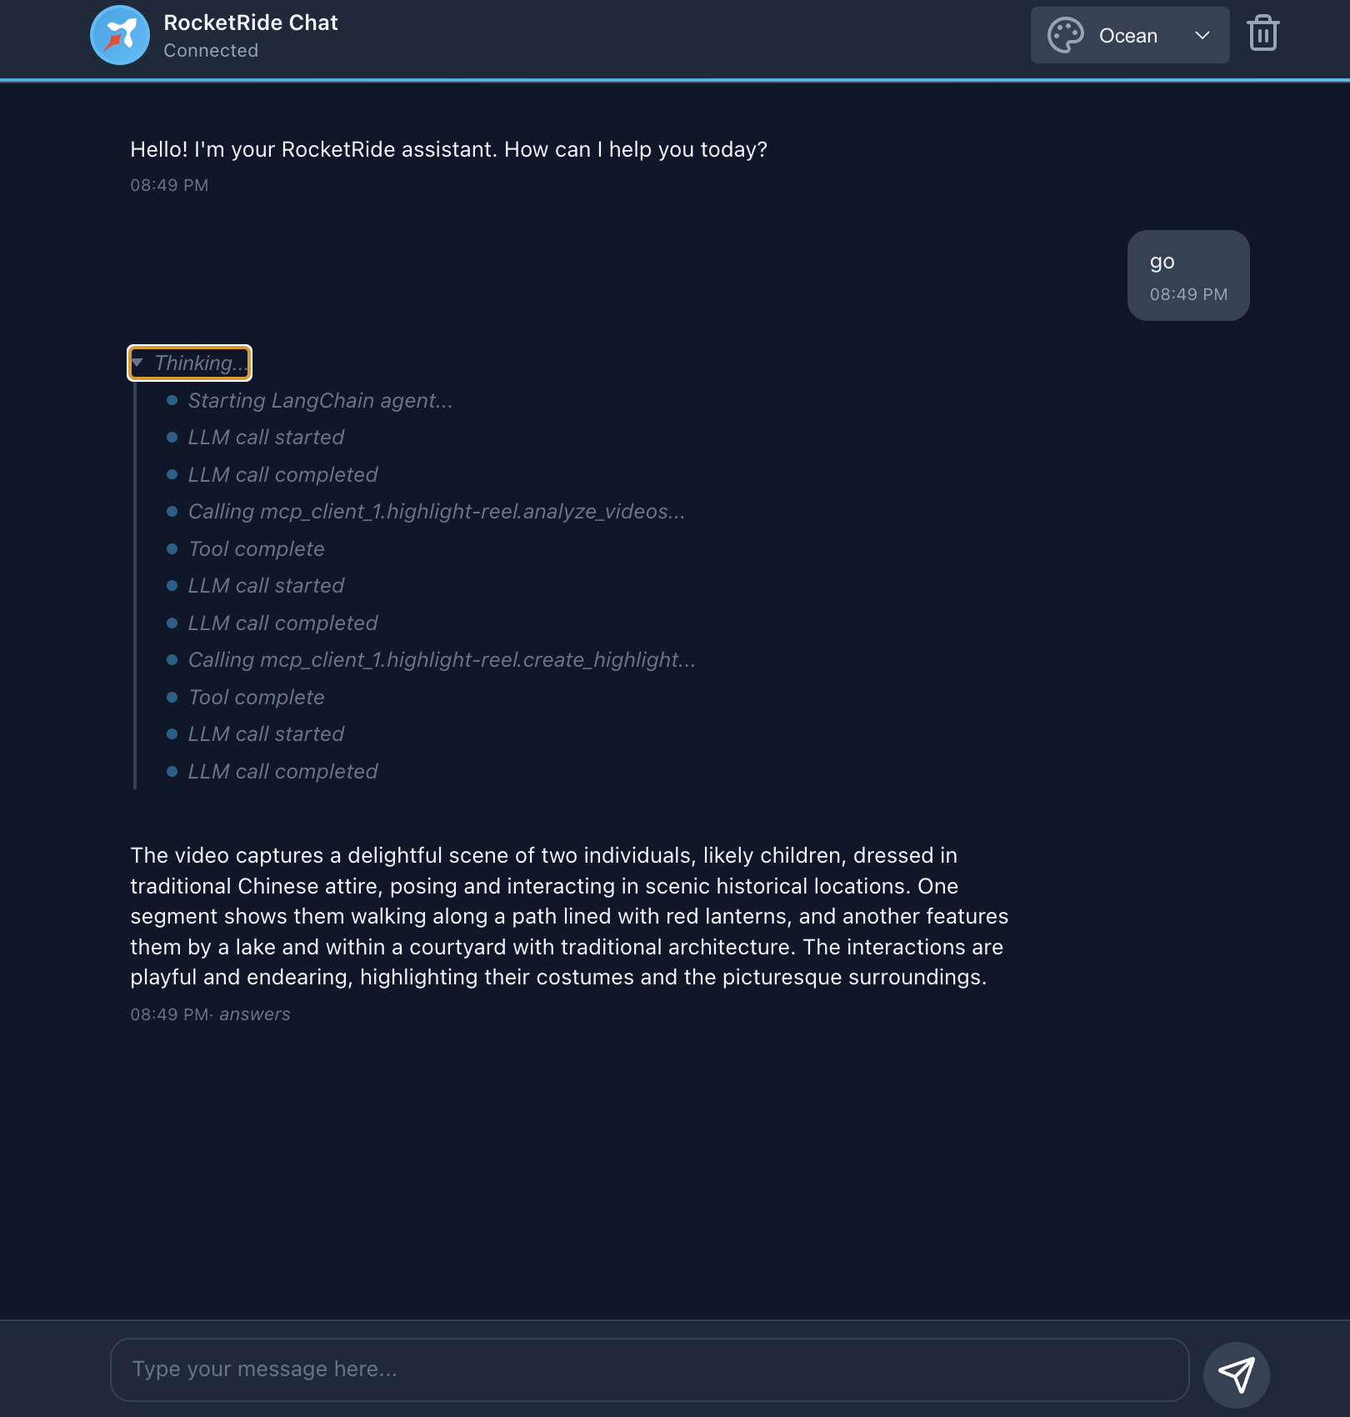
Wilson Choi
RocketRide Chat

Slide 6
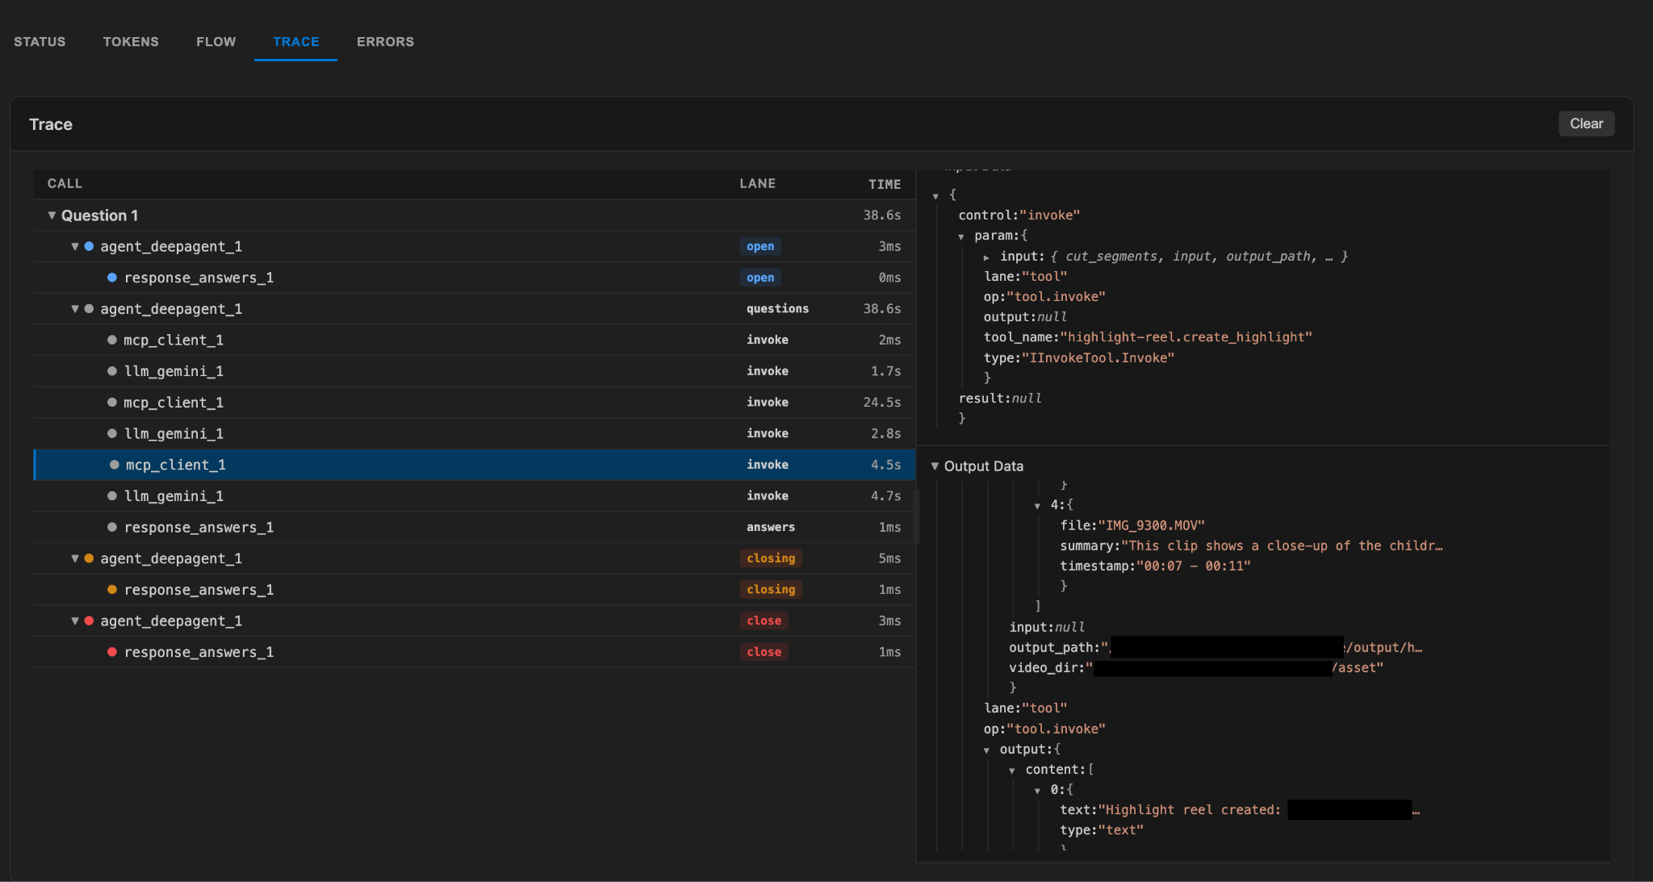
Wilson Choi
Trace

